Slide 1
Visualizing Data
Hongyi Zhu, Sagar Samtani, Hsinchun Chen
Acknowledgements:
Katy Börner, School of Informatics and Computing, Indiana University, USA
Robert Putnam, Research Computing, IS&T, Boston University, USA

Slide 2
Outline
Overview
A Visualization Framework
A Visualization Workflow
Evaluation Research of Information Visualization
Tools Overview
Resources

Slide 3
Overview
Definition of Visualization
A Brief History of Visualization
Visualization Classification
Value of Information Visualization
Goals of Information Visualization

Slide 4
What is Visualization?
Visualization is any technique for creating images, diagrams, or animations to communicate a message.
Visualization through visual imagery has been an effective way to communicate both abstract and concrete ideas since the dawn of man.
Cave paintings
Hieroglyphs
Maps
…

Slide 5
Brief History
First known map: 12th century (Tegarden,1999)
First presentation graphics: William Playfair (1786)
Multidimensional representations appeared in 19th century (Tufte, 1983)
Examples:
William Playfair (1821) – Chart showing at one view the price of the quarter of wheat, & wages of labor by the week, from the year 1565 to 1821
John Snow (1854) – Cholera Map in London
Charles Joseph Minard (1861) – Napoleon and The Russian Campaign of 1812

Slide 6
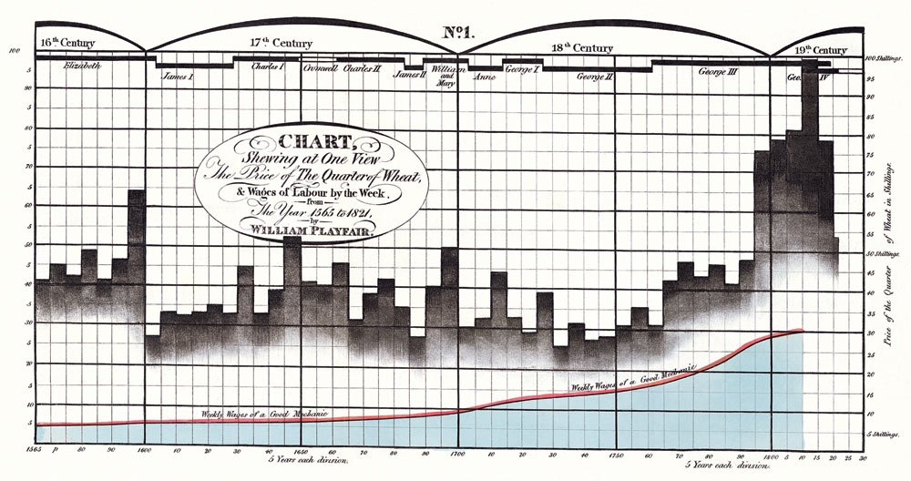
Brief History
Time-series comparison, aimed to show wheat price declined regarding the increase of wages
Integration of bar charts and line graph
William Playfair (1821)

Slide 7
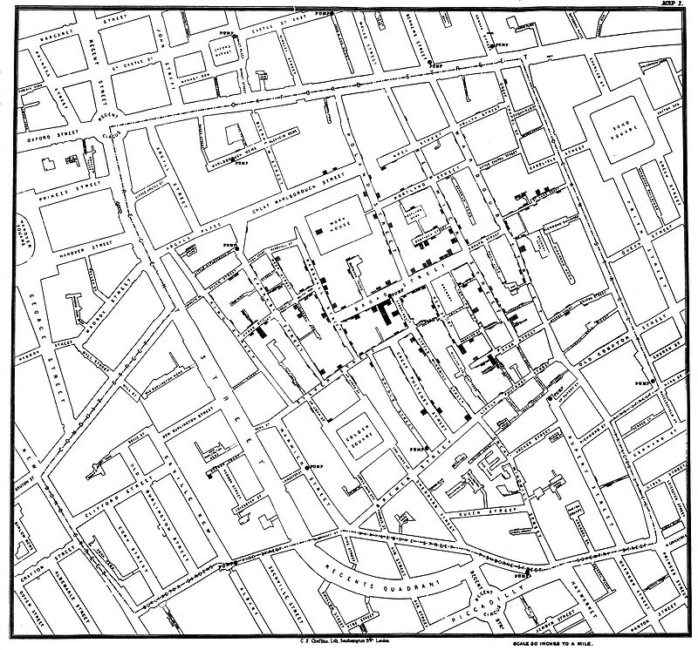
Brief History
John Snow mapped the cholera cases on the map. The cases were clustered around the pump in Broad street.
Each death case is a bar
“Spot map” – Geo-spatial based mapping
John Snow (1854)

Slide 8

Brief History
In this visualization, Minard visualized:
Napoleon’s marching and retreat routes
Army Size
Temperature during retreat
Charles Joseph Minard (1861)

Slide 9
Brief History
Modern Visualization
1985: NSF Workshop on Scientific Visualization
1987: Special issue of Computer Graphics on Visualization in Scientific Computing
1990: IEEE 1st visualization conference
2000s: Public media started to integrate infographics into TV news, newspaper/ magazine publication
2004: Pak Chung Wong and J. Thomas (2004). ”Visual Analytics”. in: IEEE Computer Graphics and Applications, Volume 24, Issue 5, Sept.-Oct. 2004 Page(s): 20–21.
Visualizations become popular on social networks
Techniques such as HTML5, CSS3 enabled interactive visualizations on mobile devices

Slide 10
Visualization Classification
Visualization can be classified as software visualization, scientific visualization, and information visualization.
Software Visualization
Software visualization helps people understand and use computer software effectively (Stasko et al. 1998)
Scientific Visualization
Visualizing three-dimensional phenomena (architectural, meteorological, medical, biological, etc.), where the emphasis is on realistic renderings of volumes, surfaces, illumination sources, and so forth (Friendly , 2008)

Slide 11
Visualization Classification
Information Visualization
Information visualization is the two-way and interactive interface between humans and their information resources. Visualization technologies meld the human’s capacity with the computational capacity for analytical computing. (P1000 report)
Information visualization concentrates on the use of computer-supported tools to explore large amount of abstract data. The abstract data include both numerical and non-numerical data, such as text and geographic information.

Slide 12
Value of Information Visualization
Exploring information collections becomes increasingly difficult as the volume grows
With minimal effort, the human visual system can process a large amount of information in a parallel manner
The occurrence of advanced graphical software and hardware enables the large-scale visualization and the direct manipulation of interfaces

Slide 13
Goals for Information Visualization
Provide insight
Explain data to solve specific problems
Support the analytical task, showing the comparison or causality
Explore large data sets for better understanding
Relieve the cognitive overload
Conveying abstract information in intuitive ways

Slide 14
A Visualization Framework
How to organize and group information visualizations?

Slide 15
How to Organize Visualizations?
By
User task type?
User insight need?
Data to be visualized?
Data transformation?
Visualization techniques?
Visual mapping transformation?
Interaction techniques?
…?

Slide 16
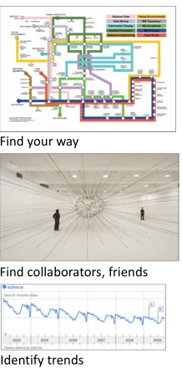
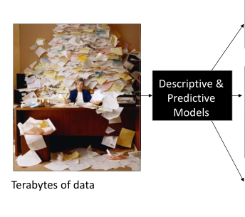
Different Question Types

Slide 17
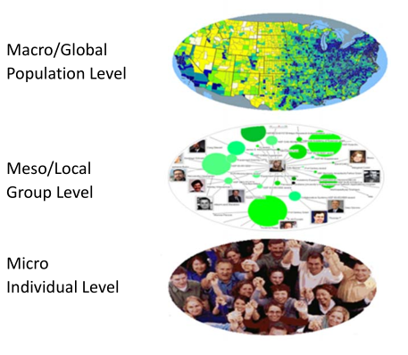
Different Levels of Analysis

Slide 18
Framework by Börner (2014)
 | Micro/Individual (1-100 records) | Meso/Local (101-10,000 records) | Macro/Global (10,000+ records)
Statistical Analysis/Profiling | Individual person and their expertise profiles | Larger labs, centers, universities, research domains, or states | All of NSF, all of USA, all of science.
Temporal Analysis (When) | Funding portfolio of one individual | Mapping topic bursts in 20 years of PNAS | 113 years of physics research
Geospatial Analysis (Where) | Career trajectory of one individual | Mapping a state’s intellectual landscape | PNAS publications
Topical Analysis (What) | Base knowledge from which one grant draws | Knowledge flows in chemistry research | VxOrd/Topic maps of NIH funding
Network Analysis (With Whom) | NSF Co‐PI network of one individual | Co‐author network | NIH’s core competency
Notes:
Describe various visualization techniques (what they are, why they are useful, various applications, pros and cons, tips for each one):
Line, bar, scatter plots charts (2-3 slides)
Dashboards (2-3 slides)
Networks (2-3 slides)
Map based visualizations (2-3 slides)
Temporal visualizations (2-3 slides)
…
Also provide a taxonomy succinctly summarizing each of these visualizations strengths, weaknesses, and the type of data that should be used for the visualization (e.g., graph data for network visualizations)

Slide 19
A Visualization Workflow
A needs-driven workflow
How to select visualization types?
How to visually encode data?
How to visualize dynamically? – Animation and Interaction
Some principles for designing good visualizations.

Slide 20
Comparing Two Workflows
Börner (2014) – Visual Insights
Read data
Analyze data
Visualize
Select vis. types
Overlay data
Visually encode data
Deploy
Fry (2007) – Visualizing Data
Acquire
Parse
Filter
Mine
Represent
Refine
Interact

Slide 21
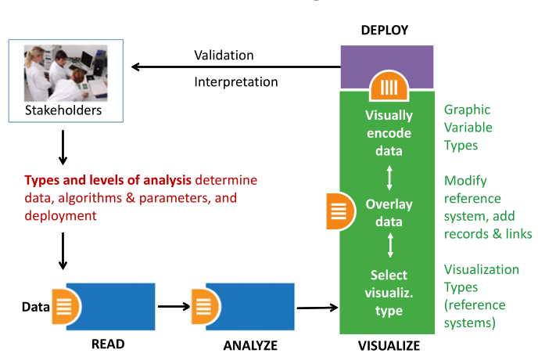
Needs‐Driven Workflow
Börner (2014)

Slide 22
Needs‐Driven Workflow – Select Visualization Type
Börner (2014)

Slide 23
Visualization Types
Shneiderman (1996) proposed seven types of representation methods:
1-D
To represent information as one-dimensional visual objects in a linear (Eick et al., 1992; Hearst, 1995) or a circular (Salton et al.,1995) manner.
Textual documents, source codes, name lists, and etc.
2-D
To represent information as two-dimensional visual objects
Geographic maps, floor plans, newspaper layouts and etc.
3-D
To represent information as three-dimensional visual objects
Molecules, human bodies, buildings and etc.
Multi-dimensional
To represent information as multidimensional objects and projects them into a three-dimensional or a two-dimensional space.
Relational and statistical database.

Slide 24
Visualization Types
Shneiderman (1996) proposed seven types of representation methods (cont’d):
Temporal
To represent information based on temporal order
Medical records, project management, historical presentations and etc.
Tree
To represent hierarchical relationship
Network
To represent complex relationships that a simple tree structure cannot capture

Slide 25
Visualization Types
Börner (2014) emphasized five major types:
Charts
No reference system—e.g., Wordle.com, pie charts
Tables
Categorical axes that can be selected, reordered; cells can be color coded and might contain proportional symbols. Special kind of graph.
Graphs
Quantitative or qualitative (categorical) axes. Timelines, bar graphs, scatter plots.
Geospatial maps
Use latitude and longitude reference system. World or city maps.
Network graphs
Node position might depends on node attributes or node similarity.
Tree graphs: hierarchies, taxonomies, genealogies.
Networks: social networks, migration flows.

Slide 26
Visualization Type Selection: Temporal
Temporal data analysis and visualization answer “WHEN” question and can help to
Understand the temporal distribution of datasets
Identify growth rates, latency to peak times, or decay rates
See patterns in time-series data, such as trends, seasonality, or bursts.

Slide 27
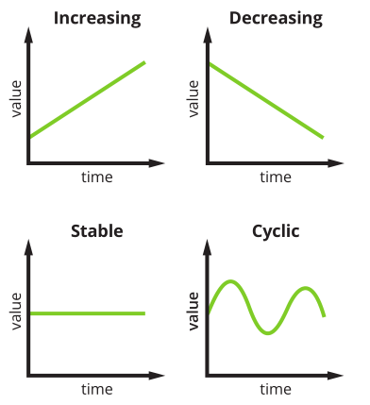
Visualization Type Selection: Temporal
Temporal trends
Increasing
Decreasing
Stable
Cyclic
Visualization Types
Line graph
Stacked graph
Temporal bar graph
Histograms
Small multiples

Slide 28
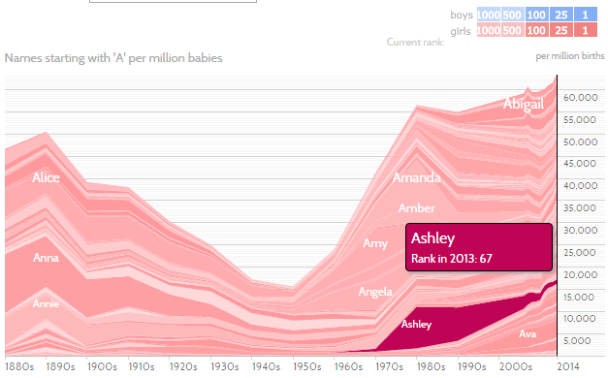
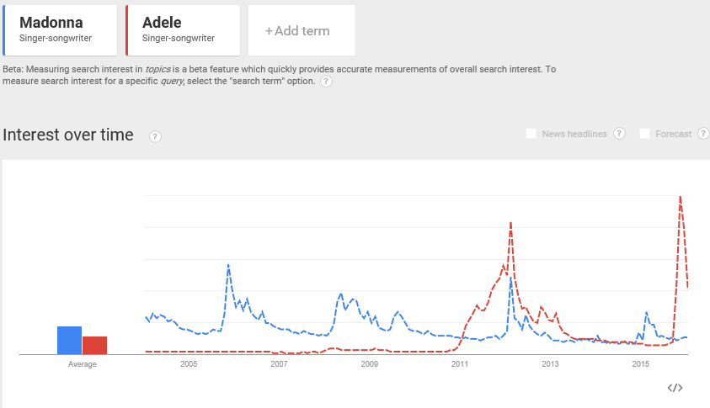
Visualization Type Selection: Temporal
Line graph shows the trends over time.
Stacked graph illustrates individual and total trends.

Slide 29
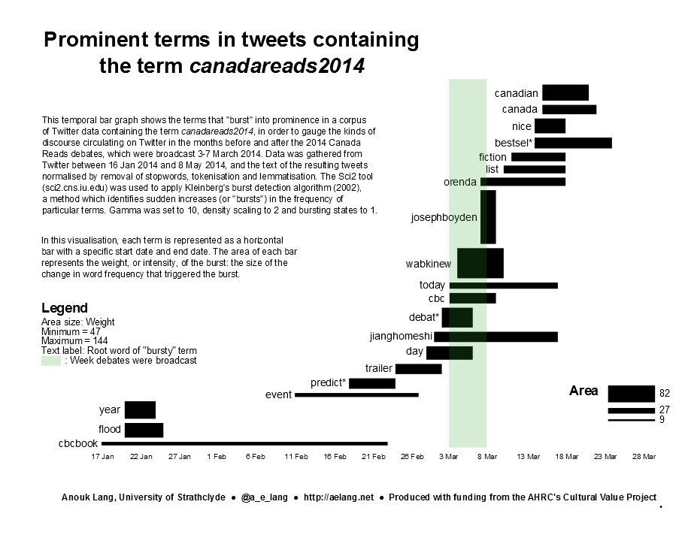
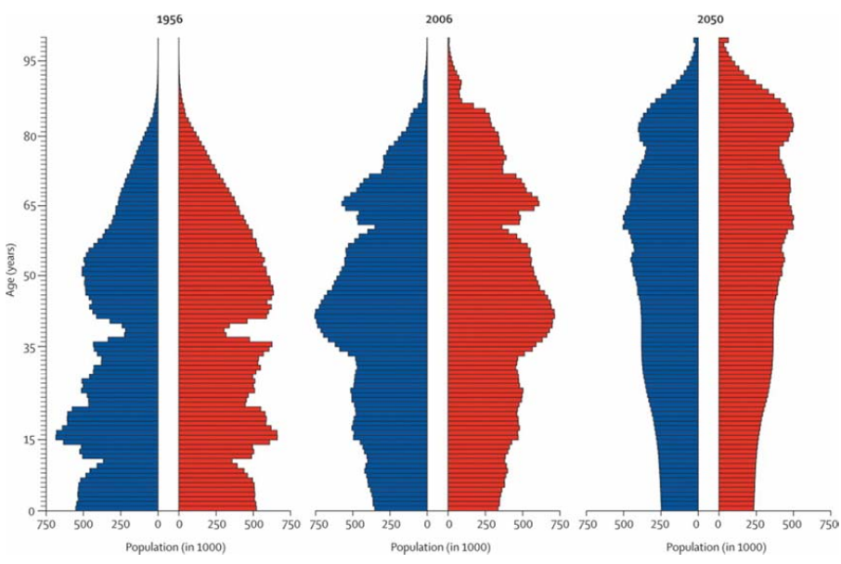
Visualization Type Selection: Temporal
Temporal bar graph shows begin, end, and properties of events.
Histograms represent the number of observations of a certain value have been made.
Christensen, Kaare, Gabriele Doblhammer, Roland Rau, and James W. Vaupel. “Ageing Populations: The Challenges Ahead.” The Lancet 374 (9696): 1196-1208.

Slide 30
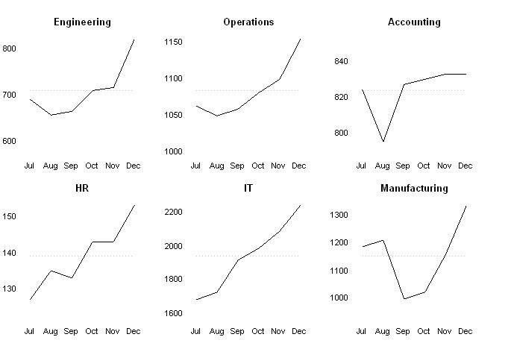
Visualization Type Selection: Temporal
A small multiple (sometimes called trellis chart, lattice chart, grid chart, or panel chart) is a series of similar graphs or charts using the same scale + axes, allowing them to be easily compared. (Tufte, 1983).

Slide 31
Visualization Type Selection: Geospatial
Geospatial data analysis and visualization originated in geography and cartography, but are increasingly common in statistics, information visualization, and many other areas of science.
The analyses aim to answer “WHERE” questions that use location information to identify their position or movement over geographic space.

Slide 32
Visualization Type Selection: Geospatial
General Map Types
General reference maps
Topographic maps
Thematic maps: Emphasize the spatial distribution of one or more geographic variables
Physio-geographical:
Maps showing the natural features of the earth's surface.
Socio-economic:
Maps showing political boundaries, population density, or voting behavior.
Technical
Maps showing navigation routes.

Slide 33
Visualization Type Selection: Geospatial
Different map types
Proportional symbol map
Choropleth map
Heat (isopleth) map
Cartograms
Flow maps
Space-time cubes

Slide 34
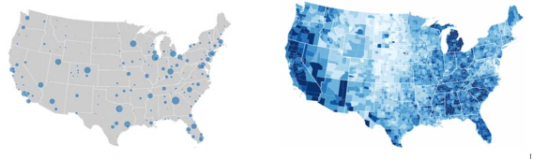
Visualization Type Selection: Geospatial
Proportional symbol map represents data variables by symbols that are sized, colored, etc. according to their amount. Data is (or can be) aggregated at points within areas.
Choropleth map represents data variables such as densities, ratios, or rates by proportionally colored or patterned areas.

Slide 35
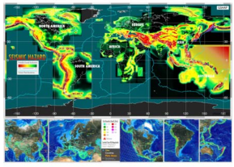
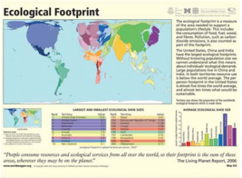
Visualization Type Selection: Geospatial
Heat (isopleth) maps represent continuous data variable values by colors. Heat maps might show color-based contour lines that connect points of equal value or value-by-area maps.
Cartograms are not drawn to scale. Instead they distort geographical areas in proportion to data values. Familiarity with region is necessary. Mostly used for world, continental, and country maps.

Slide 36
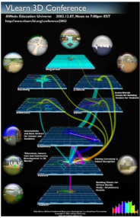
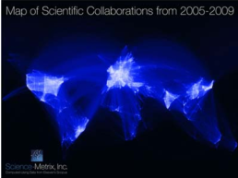
Visualization Type Selection: Geospatial
Flow maps show the paths that (in)tangible object take to get from one geospatial place to another. Variables such as capacity or maximum speed are encoded proportionally by line width or color.
Space-time cubes display entities, locations, and events over time.

Slide 37
Visualization Type Selection: Topical
To answer “WHAT” question, we will be using texts to identify major topics, their interrelations, and their evolution over time at different levels of analysis – micro to macro.
To generate visualization from text, text processing or natural language processing is needed to generate qualitative or quantitative features of the text.

Slide 38
Visualization Type Selection: Topical
Most of the time, we would not just analyze one piece of text, but we would analyze an entire text corpus instead.
Bag of Words and N-gram are techniques we will likely encounter in the area.
Other text mining techniques such as text classification, sentiment analysis, topic modeling, entity extraction were reviewed by Xiao.
https://ai.arizona.edu/class-resources-page
Text Mining: Techniques, Tools, Ontologies and Shared Tasks, by Xiao Liu

Slide 39
Visualization Type Selection: Topical
Representations of Topical Data
Charts: Word cloud, text overlay
Tables: GRIDL, Periodic table
Graphs: circular visualization, crossmaps
Geospatial maps: SOM maps
Network graphs: Tree visualizations, word co-occurrence networks, concept maps, science map overlays

Slide 40
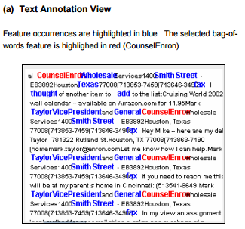
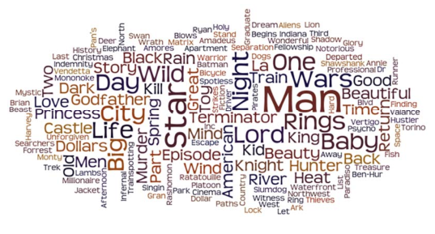
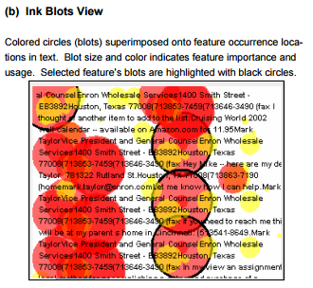
Visualization Type Selection: Topical
Word cloud visualize the frequency of the words.
IMDB movie titles word cloud created with Wordle.
Text Overlay (Abbassi and Chen, 2008)

Slide 41
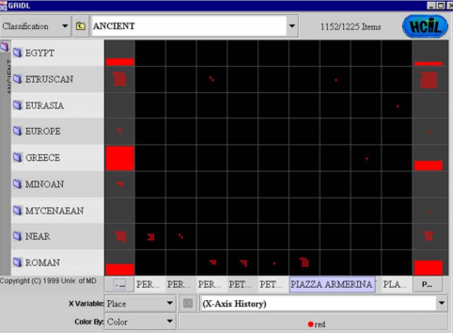
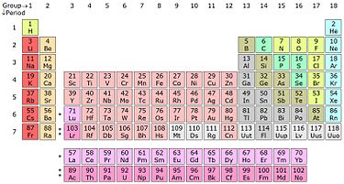
Visualization Type Selection: Topical
GRIDL uses categorical and hierarchical axes to support categorical zooming.
Periodic Table is used to organize elements sharing similar properties.

Slide 42
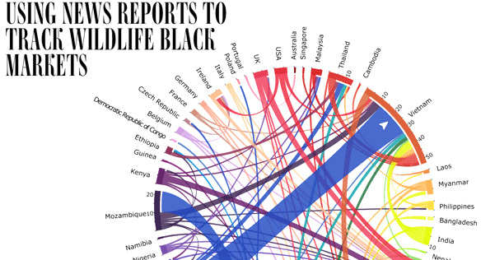
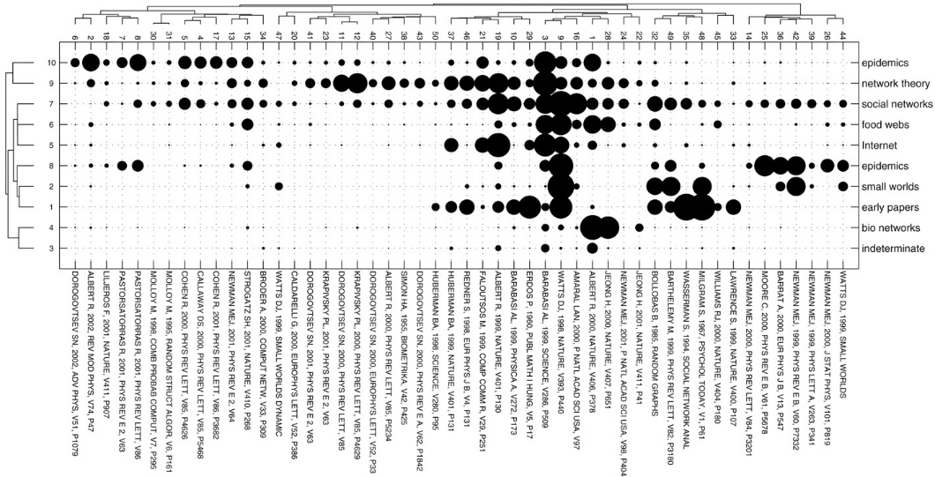
Visualization Type Selection: Topical
Circular Visualization shows the relationships between entities.
Crossmap is introduced for visualizing multiple and overlapping relations among entity types in collections of journal articles.

Slide 43
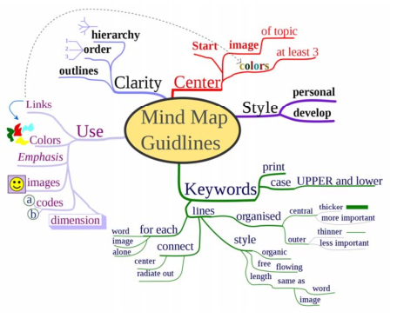
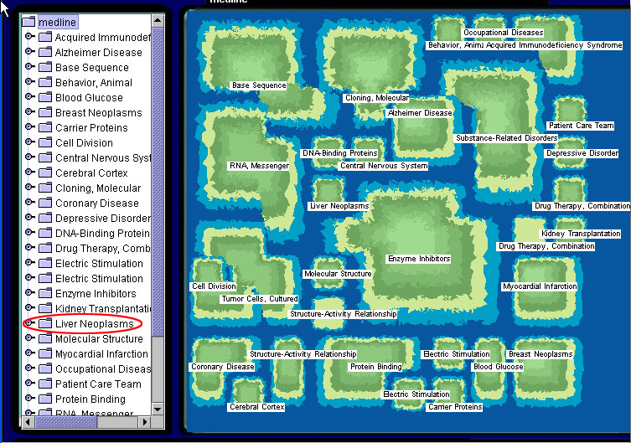
Visualization Type Selection: Topical
SOM Map uses geospatial metaphors to create abstract 2-D space and map elements onto the space.
Concept maps are network graphs that show the relationships among concepts.

Slide 44
Visualization Type Selection: Network
The “WITH WHOM” question can be answered by tree and network visualization.
Tree visualization utilizes structural, hierarchical data.
Radial Tree Map
Treemap
Network visualization can deal with more complex relationships between nodes.
Random layout
Circular layout
Force directed layout
Bipartite layout
Subway map layout
Network overlays on geospatial maps

Slide 45
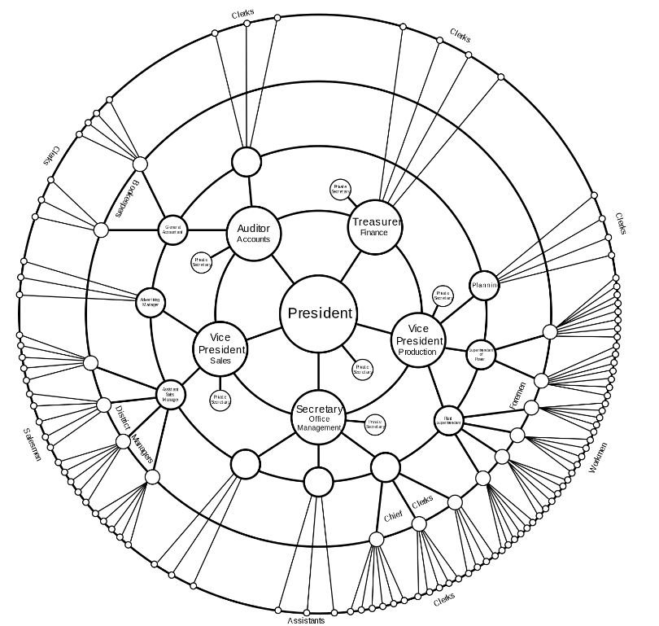
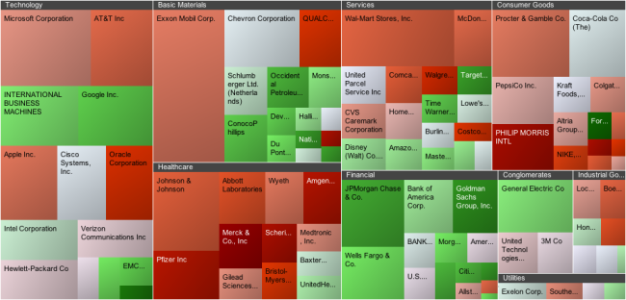
Visualization Type Selection: Network
Radial Tree Map is a method of displaying a tree structure in a way that expands outwards, radially.
Treemap is a space-constrained visualization of hierarchical structure, proposed by Ben Shneiderman during 1990s.

Slide 46
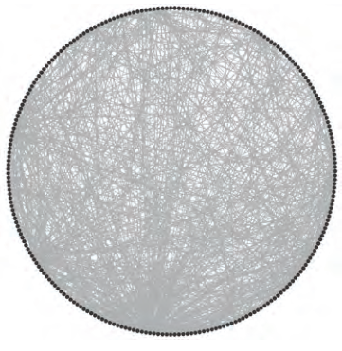
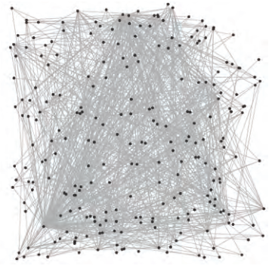
Visualization Type Selection: Network
Random layout
Fast
Impression of size and density
Circular layout
Fast
Can provide sequential information

Slide 47
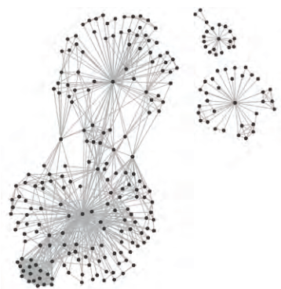
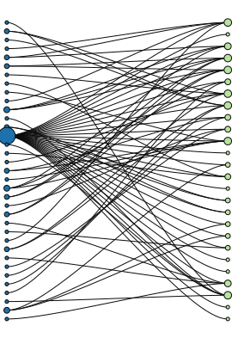
Visualization Type Selection: Network
Force directed layout
Utilizes similarity or distance relationships among nodes
Bipartite layout
Renders networks with two node types as two lists.

Slide 48
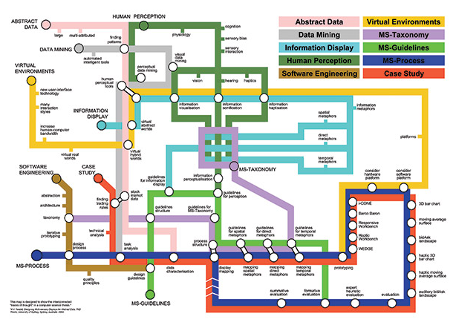
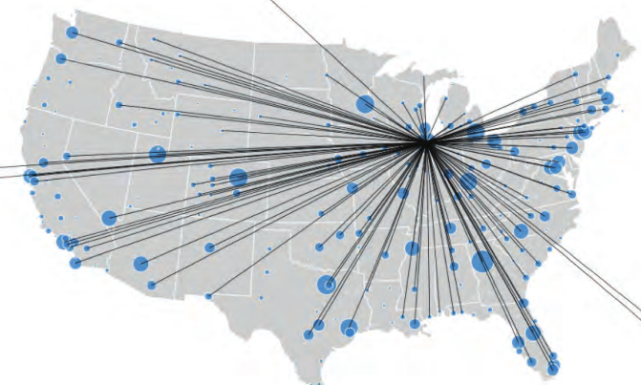
Visualization Type Selection: Network
Subway map layout
Aim for evenly distributed nodes, uniform edge lengths, and orthogonal drawings.
E.g. Ph.D. Thesis map (2004)
Network overlays on geospatial maps
Use a geospatial reference system to place nodes
E.g., airport traffic

Slide 49
Needs‐Driven Workflow – Visually Encode data
Börner (2014)

Slide 50
Data Scale Types
Categorical (nominal): A categorical scale, also called nominal or category scale, is qualitative. Categories are assume to be non-overlapping.
Ordinal: An ordinal scale, also called sequence or ordered, is qualitative. It rank-orders values representing categories based on some intrinsic ranking but not at measureable intervals.
Interval: An interval scale, also called value scale, is a quantitative numerical scale of measurement where the distance between any two adjacent values (or intervals) is equal but the zero point is arbitrary.
Ratio: A ratio scale, also called proportional scale, is a quantitative numerical scale. It represents values organized as an ordered sequence, with meaningful uniform spacing, and has a true zero point.
More
Qualitative
More
Quantitative

Slide 51
Data Scale Types – Example
Categorical (nominal): Words or numbers constituting the names and descriptions of people, places, things, or events.
Ordinal: Days of the week, degree of satisfaction and preference rating scores (e.g., Likert scale), or rankings such as low, medium, high.
Interval: Temperature in degrees or time in hours. Spatial variables such as latitude and longitude are interval.
Ratio: Physical measures such as weight, height, (reaction) time, or intensity of light; number of published papers, co-authors, citations.

Slide 52
Graphic Variable Types
Quantitative
Position
x, y; possibly z
Form
Size
Color
Value (Lightness, Brightness)
Saturation (Intensity)
Texture
Pattern
Rotation
Coarseness
Size
Density gradient
Qualitative
Form
Shape
Orientation (Rotation)
Color
Hue (tint)
Optics
Crispness
Transparency
Shading

Slide 53
Dynamic Visualization
Previous sections demonstrates the workflow to create a static visualization.
In order to present more information and make visualization dynamic, we can show multiple static images side by side or as an animation.
Another way to make dynamic visualization is to introduce interaction into the design process.

Slide 54
Shneiderman's Mantra
User-Interface Interaction
Immediate interaction not only allows direct manipulation of the visual objects displayed but also allows users to select what to be displayed (Card et al., 1999)
Shneiderman (1996) summarizes six types of interface functionality
Overview
Zoom
Filtering
Details on demand
Relate
History
“Overview first, zoom and filter, then details-on-demand.”

Slide 55
Two Interaction Approaches
User-Interface Interaction
Overview + detail
First overview provides overall patterns to users; then details about the part of interest to the use can be displayed. (Card et al., 1999)
Spatial zooming & semantic zooming are usually used
Focus + context
Details (focus) and overview (context) dynamically on the same view. Users could change the region of focus dynamically.
Information Landscape( Andrews, 1995)
Cone Tree (Robertson et al., 1991)
Fish-eye (Furnas, 1986)

Slide 56
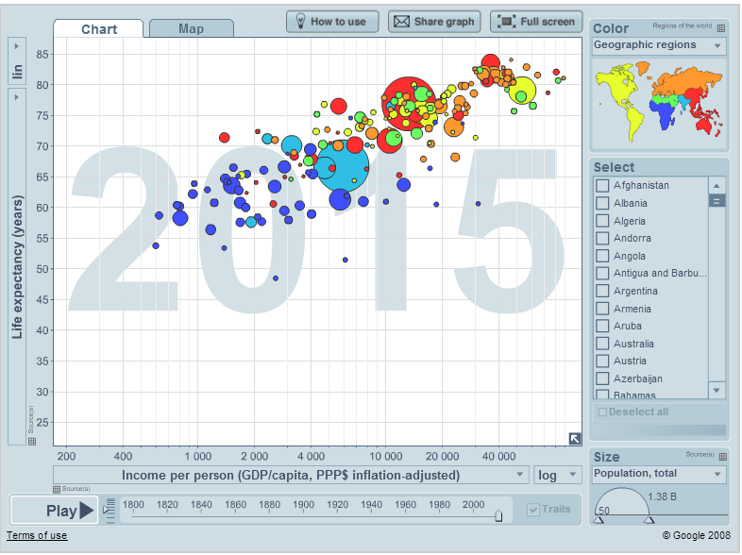
Interactive Vis. Example: Gapminder World
http://www.gapminder.org/world/
https://www.youtube.com/watch?v=BPt8ElTQMIg (Hans Rosling telling story)

Slide 57
Design Principles
Following design principles can help increasing the quality of visualizations in multiple ways.
Effective information presentation
Avoiding distraction and confusion, reducing cognitive load
Adding aesthetic value
Some selected principles
Beauty of Visualization
Data-Ink Ratio
Data Density
Color Heuristics
Fitts’s Law

Slide 58
Beauty of Visualization
In Beautiful Visualization (2010), four criteria were raised to define the beauty of Visualization:
Informative
Successfully convey information
Efficient
Simple, focused, clear and straightforward
Aesthetic
Use axes, layout, shape, colors, lines, and typography appropriately
Novel
Be creative and attract readers with new design

Slide 59
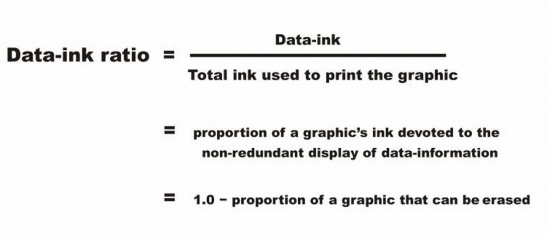
Data-Ink Ratio
In The Visual Display of Quantitative Information (1983), Tufte claims that good graphical representations maximize data-ink and erase as much non-data-ink as possible.
Non-data-ink: Scales, borders, and etc.

Slide 60
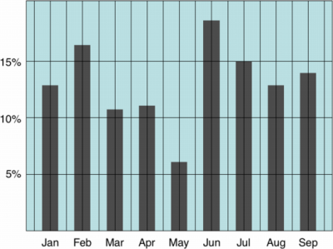
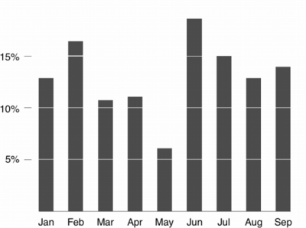
Data-Ink Ratio
Low Data-Ink Ratio
High Data-Ink Ratio

Slide 61
Data Density
The data density of a graph is the proportion of the total size of the graph that is dedicated to displaying data. (Tufte, 1983)
Similar to Data-Ink Ratio, Tufte prefers visualizations with high Data Density.
He claims that most graphs can be shrunk way down without losing legibility or information.

Slide 62

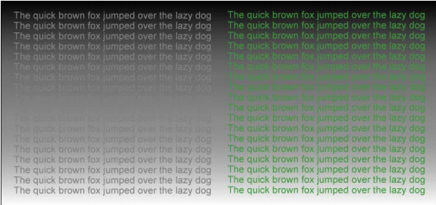
Color Heuristics
Contrast and analogy are the principles that define color design.
Contrasting colors are different, analogous colors are similar.
Contrast draws attention, analogy groups.
Color-coded information should be legible.
Legibility: difference between foreground and background colors
https://www.perceptualedge.com/articles/b-eye/choosing_colors.pdf
http://cdn2.hubspot.net/hub/111084/file-708877165-pdf/docs/ebooks/eBook-UX-Color-Theory_Applying-Color-Knowledge-to-Data-Visualization.pdf

Slide 63
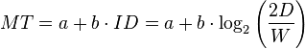
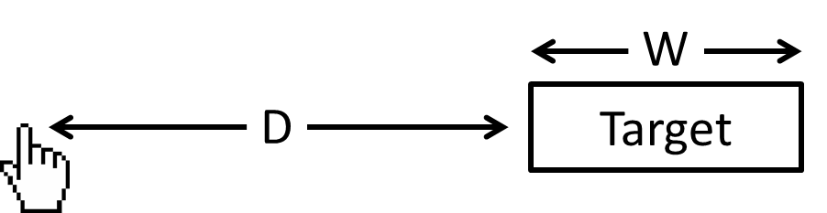
Fitts's Law
Fitts's is a descriptive model of human movement primarily used in human–computer interaction and ergonomics. It may apply to interactive visualization design.
MT: Movement time
ID: Index of difficulty
D: Distance
W: Width
Fitts’s Law indicates that, to shorten the movement time and lower the index of difficulty, an HCI design should:
Shorten the distance to the target
Group functions/buttons together to reduce redundant movements
Enlarge the Target

Slide 64
Zipdecode: Workflow Illustration
This is a simple example illustrating the visualization workflow:
Read data
Analyze data
Select visualization type
Data overlay
Visually encode data
Deploy (Interactive design)

Slide 65
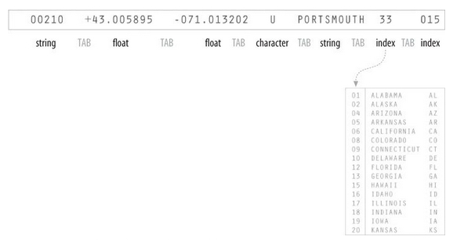
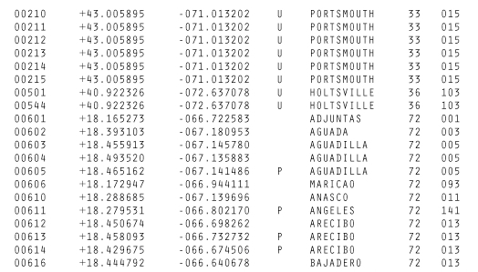
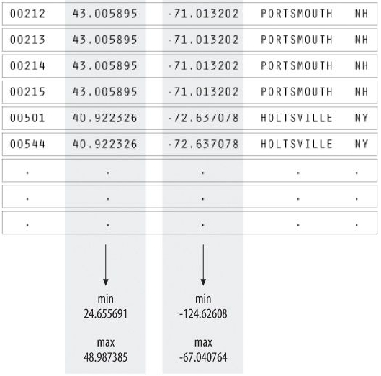
Read and Analyze data
Zipcode | Latitude | Longitude | Post Office Type | City Name | State Index | Other Index
Analyze Data
Zipcode | Latitude | Longitude | City Name | State Abbr.
Acquire Data
Mine and Filter Data
(Fry, Visualizing Data, 2007)

Slide 66
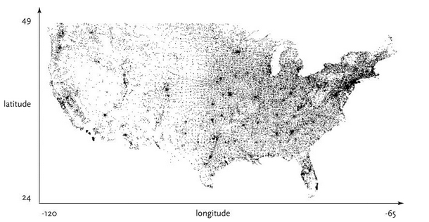
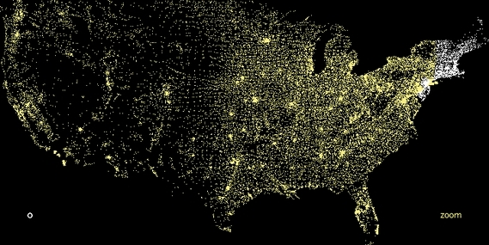
Vis. Type Selection, Data Overlay and Visually Encode
Vis. Type: Map
Data Overlay
Latitude
Longitude
Visually Encode (Lights at night)
Background: Black
Selected: White
Unselected: Yellow
(Fry, Visualizing Data, 2007)

Slide 67
Deploy (Interact)
http://benfry.com/zipdecode/

Slide 68
Evaluation Research

Slide 69
Evaluation Research of Information Visualization
Empirical usability studies
To understand the pros and cons of specific visualization designs or systems
Laboratory experiments approach
Comparing a glyph-based interface and a text based interface (Zhu & Chen 2001)
Comparing different visualization techniques (Stasko et al., 2000)
De-featuring approach
Several studies have been conducted to evaluate popular tree representations, such as Hyperbolic Tree (Pirolli et al., 2000), Treemap (Stasko et al., 2000), and multilevel SOM (Ong et al., in press)
Complex, realistic, task-driven evaluation studies have been conducted frequently, e.g. (Pohl & Purgathofer, 2000; Risden et al., 2000; North and Shneiderman, 2000). They could measure usefulness. But it is difficult to identify each visualization factors’ contribution.
Behavioral methods also need to be considered

Slide 70
Evaluation Research of Information Visualization
Fundamental perception studies and theory building
To investigate basic perceptual effects of certain visualization factors or stimuli
Theories from psychology and neuroscience are used to understand the perceptual impact of visualization parameters as animation (Bederson & Boltman, 1999), information density (Pirolli et al., 2000), 3-D effect (Tavanti & Lind, 2001)and combinations of visual cues (Nowell et al., 2002)
It usually involves some form of computer-based visualization
Bederson and Boltman (1999) used the Pad++ to study the impact of animation of users’ learning of hierarchical relationships
Pirolli et al. (2000) used a hyperbolic tree with fish0eye view to study the effect of information density.
Results may be applied only to the particular visualization system understudy

Slide 71
Tools Overview

Slide 72
Visualization Tools
Various types of visualization tools are available online.
Desktop Software | Online Services | Toolkit (for Developers)
Microsoft Excel | Mapbox | D3.js
Sci2 Tool | Wordle | Google Charts
Gephi | Datawrapper | HighCharts
Tableau | Infogram | Processing
TIBCO Spotfire | Plotly | R/Python/Matlab
… | … | …

Slide 73
Desktop Software
Microsoft Excel
Excel supports charts, graphs, or histograms generated from specified groups of cells.
Sci2 Tool (Open source)
The Science of Science (Sci2) Tool is a modular toolset specifically designed for the study of science. It supports the temporal, geospatial, topical, and network analysis and visualization of scholarly datasets at the micro (individual), meso (local), and macro (global) levels.
https://sci2.cns.iu.edu/user/index.php
Gephi (Open source)
Gephi is the leading visualization and exploration software for all kinds of graphs and networks.
https://gephi.org/

Slide 74
Desktop Software
Tableau
The product queries relational databases, cubes, cloud databases, and spreadsheets and then generates a number of graph types that can be combined into dashboards and shared over a computer network or the internet.
TIBCO Spotfire
Similar to Tableau, TIBCO Spotfire is an integral visualization platform which can visualize various types of charts.

Slide 75
Desktop Software
Software | Charts | Maps | Networks | Cost
Microsoft Excel | √ | √ |  | License Required
Sci2 Tool | weak | √ | √ | Free
Gephi |  |  | √ | Free
Tableau | √ | √ | √ | Free for students
TIBCO Spotfire | √ | √ |  | Free trial $650 annual subscription

Slide 76
Online Services
Mapbox (https://www.mapbox.com/)
An open source mapping platform for custom designed maps. They provide APIs and SDKs to integrate location into any mobile or web app.
Wordle (http://www.wordle.net/)
A specialized tool to generate word clouds from text.
Datawrapper (https://datawrapper.de/)
Datawrapper is an open source tool helping user to quickly create simple, correct and embeddable.

Slide 77
Online Services
Infogram (https://infogr.am/)
An online tool to create visualizations and interactive infographics.
Plotly (https://plot.ly/)
An online charts and dashboards creator. Provides APIs in multiple programming languages.

Slide 78
Online Services
Services | Charts | Maps | Networks
Mapbox |  | √
Wordle | Word Cloud
Datawrapper | √ | √
Infogram | √ | √
Plotly | √ | √ | API Extension

Slide 79
Toolkits (for Developers)
These tools are APIs, SDKs, packages for programming languages, which provides high level of flexibility and enables unconstrained customizations.
D3.js
A JavaScript library for producing dynamic, interactive data visualizations in web browsers. It makes use of the widely implemented SVG, HTML5, and CSS standards.

Slide 80
Toolkits (for Developers)
Google Charts
The Google Chart API is a tool that lets people easily create a chart from some data and embed it in a web page. Google creates a PNG image of a chart from data and formatting parameters in an HTTP request.
Highcharts
Highcharts is a product that was created by the Norway based company, Highsoft. Highcharts was released in 2009, and it is a charting library written in pure JavaScript. Highcharts is free for non-commercial and personal use.

Slide 81
Toolkits (for Developers)
Processing
Processing is an open source programming language and integrated development environment (IDE) built for the electronic arts, new media art, and visual design communities with the purpose of teaching the fundamentals of computer programming in a visual context, and to serve as the foundation for electronic sketchbooks.
R/Python/Matlab
Packages in R: ggplot2, dygraphs, googleVis, choroplethr
Packages in Python: matplotlib, ggplot, pandas
Matlab: Built-in visualization modules

Slide 82
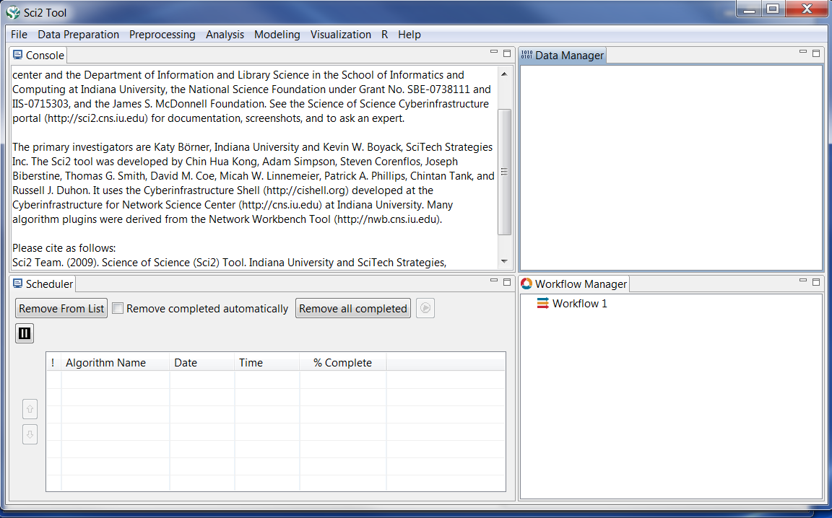
Walkthrough: Sci2 Tool
Interface: the menu bar, console, data manager, scheduler and workflow manager

Slide 83
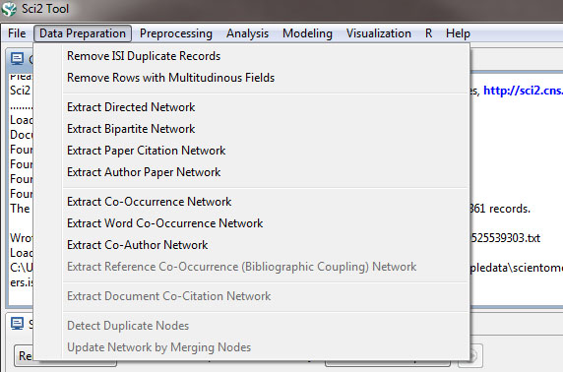
Walkthrough: Sci2 Tool
Loading the Data in Sci2
'File > Load > …’ and data will appear in the Data Manager
Data preparation
After loading a file, use options in the 'Data Preparation' menu to clean the data and create networks or tables which can be used in the preprocessing, analysis, and visualization steps.

Slide 84
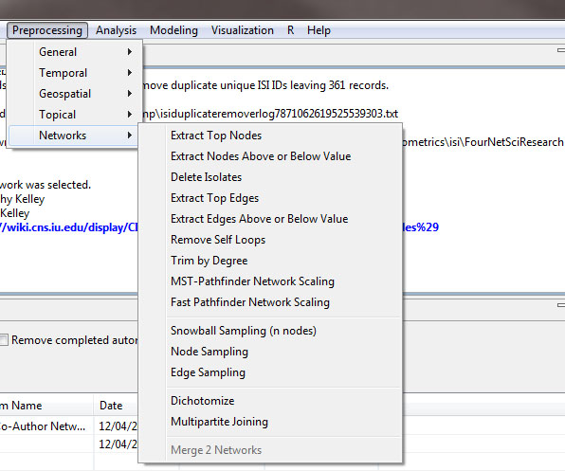
Walkthrough: Sci2 Tool
Preprocessing
Use preprocessing algorithms to prune or append networks or tables before analyzing and visualizing them.

Slide 85
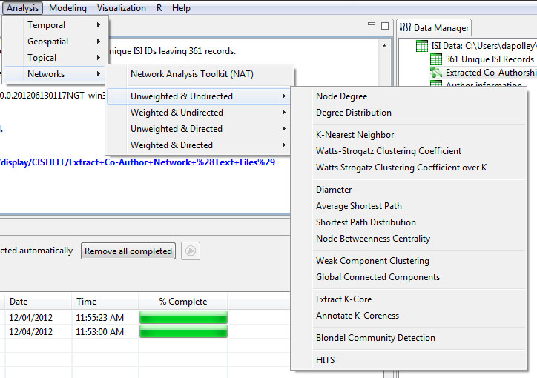
Walkthrough: Sci2 Tool
Analysis
Once data is loaded, prepared, and processed with whatever features needed, analysis is possible in each of the four domains: temporal, geospatial, topical, or network.

Slide 86

Walkthrough: Sci2 Tool
Visualize the Data
Once all previous data steps are complete, the Sci2 Tool can visualize the results.
To use Gephi, you should have Gephi installed.

Slide 87
Walkthrough: Sci2 Tool
On exporting/saving visualizations
Some visualizations do not have legends.
Inkscape is a tool which can help creating the legends
Cannot open PostScript graphs
Online converter
Gsview: http://pages.cs.wisc.edu/~ghost/
User manual and 12 PDF Tutorials on Sci2 Tool can be found online
https://sci2.cns.iu.edu/user/documentation.php

Slide 88

Walkthrough: Tableau Desktop
Connect to Data
The first thing to do when you start Tableau is to connect to your data.

Slide 89

Walkthrough: Tableau Desktop
Connect to Data

Slide 90

Walkthrough: Tableau Desktop
Build a View
After you connect to a data source, fields are displayed in the Data pane on the left side of the workbook as dimensions and measures.

Slide 91

Walkthrough: Tableau Desktop
Build a View

Slide 92

Walkthrough: Tableau Desktop
Build a View

Slide 93

Walkthrough: Tableau Desktop
Create a Story
After you create a view, you can present it in a story and show how facts are connected, provide context, and demonstrate how decisions relate to outcomes.

Slide 94

Walkthrough: Tableau Desktop
Create a Story

Slide 95
Tableau Resources
Tableau student (free): http://www.tableau.com/academic/students
Online training: http://www.tableau.com/learn/training
Quick start guide: http://www.tableau.com/support/manuals/quickstart

Slide 96
D3.js resources
Tutorials:
http://alignedleft.com/tutorials/d3
https://www.dashingd3js.com/table-of-contents
https://www.youtube.com/playlist?list=PL6il2r9i3BqH9PmbOf5wA5E1wOG3FT22p
Templates and demos:
http://techslides.com/over-1000-d3-js-examples-and-demos
http://techslides.com/over-2000-d3-js-examples-and-demos

Slide 97
Promising Trends

Slide 98
Promising Trends
Visual Data Mining
To identify patterns that a data mining algorithm might find difficult to locate
To support interaction between users and data
To support interaction with the analytical process and output of a data mining system
Virtual/ Augmented Reality-Based Visualization
To take advantage of the entire range of human perceptions, including auditory and tactile sensations
With the help of VR/AR devices (e.g., Google Glass, Hololens, Oculus Rift), visualized information can be overlaid on the real world we see.
Knowledge Visualization
To facilitate knowledge sharing and knowledge creation
Transfer insights, experiences, attitudes, values, expectations, perspectives, opinions, and predictions by using various complementary visualizations

Slide 99
Resources

Slide 100
Resources
Tufte, E. R., & Graves-Morris, P. R. (1983). The visual display of quantitative information (Vol. 2, No. 9). Cheshire, CT: Graphics press.
Tufte, E. R. (1991). Envisioning information.Optometry & Vision Science, 68(4), 322-324.
Tufte, E. R. (2006). Beautiful evidence. New York.
Tufte, E. R., & Weise Moeller, E. (1997). Visual explanations: images and quantities, evidence and narrative (Vol. 36). Cheshire, CT: Graphics Press.
Börner, K. (2014). Atlas of knowledge.
Steele, J., & Iliinsky, N. (2010). Beautiful visualization: looking at data through the eyes of experts. " O'Reilly Media, Inc.".
Fry, B. (2007). Visualizing data: exploring and explaining data with the Processing environment. " O'Reilly Media, Inc.".

Slide 101
Resources
IEEE Transactions on Visualization and Computer Graphics: http://ieeexplore.ieee.org/xpl/RecentIssue.jsp?punumber=2945
IEEE VIS Conference: http://ieeevis.org/
IEEE Computer Graphics and Applications: http://www.computer.org/web/computingnow/cga
ACM SIGGRAPH: http://www.siggraph.org/

